Slide 1



Cotiviti Intern Assessment
Clinical Decision Making & Pattern Recognition in Healthcare
Patient Readmission Risk Predictor
Presenter: Ramesh Tare
D Y Patil College of Engineering, University of Pune
August 5, 2026

Slide 2

Presentation Agenda
1. Problem Statement & Healthcare Challenge
2. Dataset Overview & Key Features
3. Methodology & Approach
4. Key Clinical Findings
5. Predictive Model Performance
6. Strategic Recommendations
7. Conclusion & Q&A

Slide 3
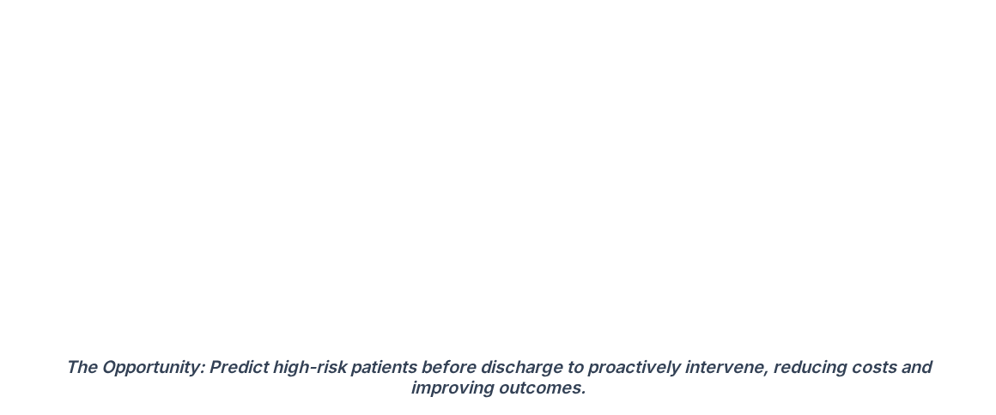




The Healthcare Challenge
20%
$17B
Readmission Rate
Annual Cost
Preventable
Of Medicare patients are readmitted within 30 days of discharge.
The staggering yearly financial burden on the US healthcare system.
A significant portion of these readmissions can be avoided with proactive care.

Slide 4

Dataset Overview: India Hospital Records (2015-2024)
Data Source / Table | Total Records | Key Features Extracted
Admissions | 120,000 | Length of Stay (LOS), Procedures, Lab Results
Patients | 86,400 | Demographics, Age, Insurance Type, BPL Status
Diagnoses | 271,341 | ICD-10 Diagnosis Codes, Comorbidities
Billing | 120,000 | Total Costs, Payment Methods, Claim Status
Hospitals | 33 | Bed Capacity, Location, Specialty Type
Target Variable: 30-Day Readmission Rate is 11.8%

Slide 5






Methodology & Analytical Approach
1. Data Processing
2. Feature Engineering
3. Predictive Modeling
Merged multiple relational tables
Created patient Acuity Scores
Trained Random Forest Classifier
Encoded categorical variables (One-Hot)
Handled missing lab values via median imputation
Implemented XGBoost for high performance
Aggregated historical admission counts
Removed outliers in length of stay (LOS)
Handled 11.8% class imbalance using SMOTE

Slide 6
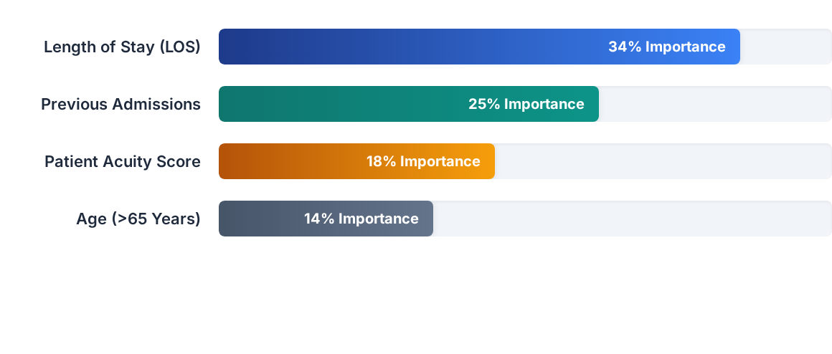
Key Clinical Findings: Top Risk Predictors
Clinical Insight: Patients with an initial Length of Stay exceeding 7 days, combined with a history of prior admissions in the last 12 months, represent the highest risk cohort for 30-day readmission.

Slide 7




Predictive Model Performance
Baseline Model (Logistic Regression)
Optimized Model (XGBoost + SMOTE)
Accuracy 72.4%
Accuracy 86.8%
AUC-ROC 0.68
AUC-ROC 0.89
Recall (Sensitivity) 54.1%
Recall (Sensitivity) 82.3%

Slide 8

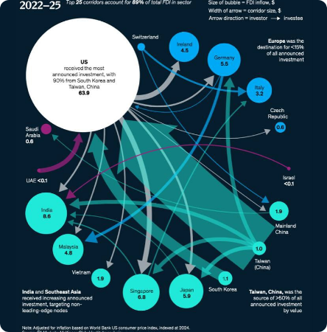
Strategic Recommendations for Cotiviti
Deploy Predictive Dashboard Integrate the XGBoost model into hospital EMR systems to flag high-risk patients 48 hours prior to discharge.
Targeted Interventions Allocate care managers specifically to the top 15% risk tier to schedule follow-up calls and home health visits.
Cost Containment Strategy By preventing just 10% of identified high-risk readmissions, partner hospitals can save approximately $2.5M annually.

Slide 9


Thank You!
Are there any questions regarding the methodology, model performance, or implementation strategy?
ramesh.tare@example.com
|
linkedin.com/in/rameshtare

Slide 10



Image Sources
https://ergsy.com/sites/default/files/styles/video_thumb/public/video_thumbs/info-image-How_should_Wegovy_tablets_be_stored_-thumb-1772059621.jpg.webp?itok=VlFzJaT5
Source: ergsy.com
https://visme.co/blog/wp-content/uploads/2024/06/12-7.jpg
Source: visme.co
https://images.stockcake.com/public/3/3/7/3378a539-4763-494f-a90a-4467baa89ff0_large/modern-hospital-design-stockcake.jpg
Source: stockcake.com

